Slide 1
UNIQUE COMMUNITY,
UNIQUE CONTENT,
UNIQUE CONVERSATIONS
Notes:
Lori:
-Welcomes everyone into room
-Intro self/James as facilitators
-Asks attendees to input their name, company, email (if comfortable) and whether you are internal HR, external to corporation into CHAT

Slide 2
About Us
We are the California connection
for Strategically Focused HR Leaders since 1994.
Our mission: Equip HR to
proactively lead the rapidly changing world of work.

Slide 3
HRSF Annual Sponsors
PLATINUM
GOLD
SILVER
BRONZE
Notes:
Lori

Slide 5
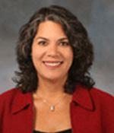
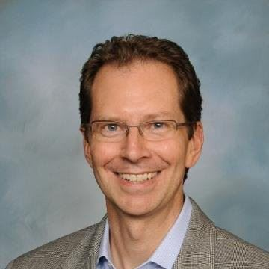
Join us March 17!
What if the talent you're seeking to hire is already on your company's payroll but going untapped? Employees often have capabilities and aspirations that go far beyond their current job descriptions. Discover a new approach to work that moves us mobilizes our workforces within the organization to rapidly adjust to changes business needs while providing new development opportunities for the talent we already have.
Our guest speakers:
Michael Fischer is VP of Global Talent Management for Sysco, a $60 Billion, 60,000 employee organization. During the early stages of the pandemic, his organization re-deployed workers from a paralyzed corporate/ restaurant market into the overheated needs of the grocery marketplace saving jobs, educating employers and supporting a key customer/grocery chain.
Edie Goldberg, Ph.D. is the President of E.L Goldberg & Associates and coauthor of The Inside Gig: How Sharing Untapped Talent Across Boundaries Unleashes Organization Capacity. (April 2020)

Slide 6
Become an HRSF Member
No additional charge to attend all programs
Access to our member directory
Access to Private Slack Community
Special reduced rates during pandemic
Corporate Memberships for groups
Join today to get the full annual benefit!

Slide 7
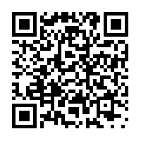
Program Evaluation
HRSF values and uses your input
Please take this 3 minute survey
Aim your phone at the QR code at left,
or click on the link in Chat,
or check the confirmation email you received.
Thanks for your attendance and support!

Slide 8
Thank You
Questions? Comments?
Stay in touch between meetings?
Interested in becoming more active?
Join our Community on Slack:
See “Join our Mailing List” on home page
https://www.hrstrategyforum.org/page/emailsignup
Or email
admin@HRStrategyForum.org

